Slide 1
Integrity and Security
Chapter - 6

Slide 2
Integrity Constraints
Integrity constraints guard against accidental damage to the database, by ensuring that authorized changes to the database do not result in a loss of data consistency.
Integrity constraints are introduced while designing the database schema.
The constraints are specified within the SQL DDL command like ‘create table’ and ‘alter table’ command.
create table r (A1 D1, 2 D2, ……An Dn, (integrity constraint₁), …… (integrity constraint_{n}));
alter table r add integrity constraint;

Slide 3
Integrity Constraints
The database system checks the specified constraint each time the database is updated.
Any updation that causes modification to the database but, violates an integrity constraint, are rejected.
It is the authorization and integrity manager who test the integrity constraint each time a database is updated.

Slide 4
Types of Integrity Constraints
Entity Integrity Constraints
Domain Constraints
Referential Integrity Constraints
Assertion

Slide 5
Entity Integrity Constraints
Entity integrity constraint ensures that the primary key attribute in a relation, should not accept a null value.
This is because the primary key attribute value uniquely defines an entity in a relation. So, it being null would not work.
create table Student (Student_id varchar (5) ,
name varchar (20) not null, depart_name varchar (20), primary key (Student_id));

Slide 6
Entity Integrity Constraints
Whenever we declare any attribute in relation as the primary key attribute then it not necessary to specify it explicitly to be not null.
In addition to primary key constraint, entity integrity constraint includes unique key constraint.
create table r (A1 D1, 2 D2, ……An Dn, unique (A_{k}1 , A_{k}2, . . . , A_{k}m) ));
The set of attributes listed as unique forms the candidate key. No two entities (tuples) in a relation must have equal values for candidate key attribute.
Candidate key attributes can accept ‘null’ values unless they are specifically declared to be ‘not null’.

Slide 7
Domain Constraints
Domain constraints are the most elementary form of integrity constraint.
Domain constraint ensures that the value associated with an attribute is justifying its domain.
Whenever we declare any relation to the database while declaring its attribute we specify a particular domain for each attribute.
The domain of an attribute specifies all the possible values that attribute can hold.
Declaring the domain of an attribute it acts as a constraint on that attribute which specifies the possible values that it can take.

Slide 8
Domain Constraints
create table Student(
Student_id varchar (5) ,
name varchar (20) not null, depart_name varchar (20), primary key (Student_id), foreign key(depart_name) references Department);
Like in the above example the name attribute of student relation can only accept string value of variable length, it cannot accept an integer value or a date or time value.

Slide 9
Constraints under Domain Constraints
There are 3 constraints under domain constraints
not null constraint
default constraint
check constraint

Slide 10
NOT NULL Constraints
Null is considered to be the legal value for all the domain specified in SQL. So, it’s ok for an attribute to have null value. But, there are some attributes which need not be null.
By specifying an attribute to be not null we restrict the domain of that attribute for not accepting the null values.
create table Student (Student_id varchar (5) ,
name varchar (20) not null, depart_name varchar (20));

Slide 11
Default Constraint
Using default value constraint, you are able to set a default value for an attribute.
For example:
create table instructor (instructor_id varchar (5), name varchar (20) not null, depart_name varchar (5), salary numeric (8,2) default 0);
This command specifies that while inserting a tuple in instructor relation if no value is provided for the salary attribute then its value is set to be 0.

Slide 12
Check Constraint
The check clause constraint ensures that when a new tuple is inserted in relation it must satisfy the predicate specified in the check clause.
create table Student (Student_id varchar (5) ,
name varchar (20) not null, depart_name varchar (20), primary key (Student_id), check (depart_name in(‘CE’, ‘CL’, ‘IT’, ‘EC’)));

Slide 13
Check Constraint
Use check clause to ensure that an hourly-wage domain allows only values greater than a specified value.
create domain hourly-wage numeric(5,2) constraint value-test check(value > = 4.00)
The clause constraint value-test is optional; useful to indicate which constraint an update violated.
Can have complex conditions in domain check
create domain AccountType char(10) constraint account-type-test check (value in (‘Checking’, ‘Saving’))
check (branch-name in (select branch-name from branch))

Slide 14
Referential Integrity Constraints
Referential integrity ensures that the values for a set of attributes in one relation must also appear the same for the particular set attributes in another relation.
Student(Student_id, name, depart_name)
id | name | Dept_name
IT-001 | Abc | IT
CH-001 | Def | CH
EE-001 | xyz | EE
Dept_Name | HOD
IT | VD
CH | MSR
MH | GDB
Error
Student
Dept

Slide 15
Referential Integrity Constraints
The student relation has an attribute that refers to an attribute of the Department relation.
So, the attribute or set of attributes in a relation referring to another relation in the database is called foreign key.
Foreign key attribute or set of attributes is guaranteed to occur as a primary key attribute of the referenced relation.
create table Student (Student_id varchar (5) ,
name varchar (20) not null, depart_name varchar (20), primary key (Student_id), foreign key(depart_name) references Department);

Slide 16
Referential Integrity Constraints
Formal Definition
Let r₁(R₁) and r₂(R₂) be relations with primary keys K₁ and K₂ respectively.
The subset α of R₂ is a foreign key referencing K₁ in relation r₁, if for every t₂ in r₂ there must be a tuple t₁ in r₁ such that t₁[K₁] = t₂[α].
Referential integrity constraint also called subset dependency since its can be written as ∏_{α} (r₂) ⊆ ∏_{K1} (r₁)

Slide 17
Referential Integrity In ER-Model
Consider relationship set R between entity sets E₁ and E₂. The relational schema for R includes the primary keys K₁ of E₁ and K₂ of E₂.
Then K₁ and K₂ form foreign keys on the relational schemas for E₁ and E₂ respectively.
Weak entity sets are also a source of referential integrity constraints.
For the relation schema for a weak entity set must include the primary key attributes of the entity set on which it depends
E1
R
E2

Slide 18
Referential Integrity Constraints
The following tests must be made in order to preserve the following referential integrity constraint:
∏_{α} (r₂) ⊆ ∏_{K} (r₁)
Insert. If a tuple t₂ is inserted into r₂, the system must ensure that there is a tuple t₁ in r₁ such that t₁[K] = t₂[α]. That is
t₂ [α] ∈ ∏_{K} (r₁)
Delete. If a tuple, t₁ is deleted from r₁, the system must compute the set of tuples in r₂ that reference t₁:
σ_{α = t1[K]} (r₂)
If this set is not empty
either the delete command is rejected as an error, or
the tuples that reference t₁ must themselves be deleted (cascading deletions are possible).

Slide 19
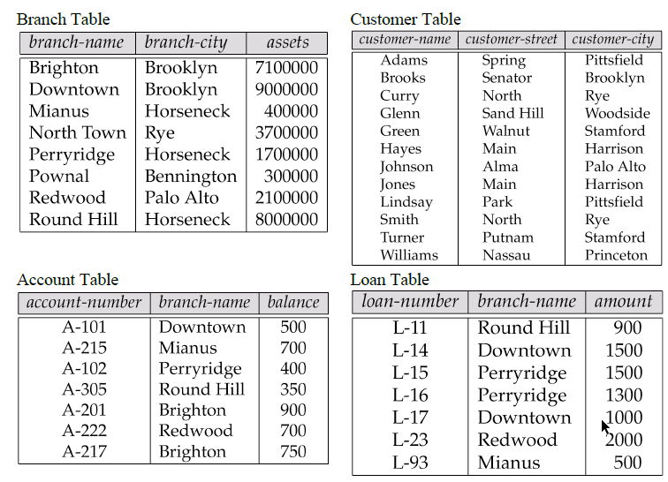

Slide 20
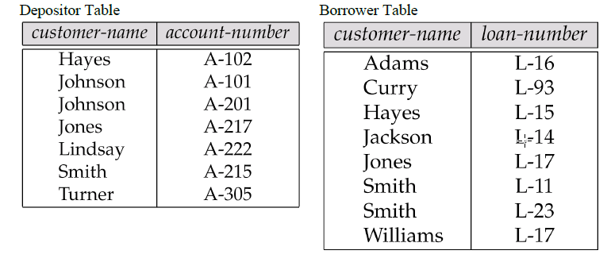

Slide 21
Referential Integrity in SQL
create table account (account-number char(10), branch-name char(15), balance integer, primary key (account-number), foreign key (branch-name) references branch)
create table depositor (customer-name char(20), account-number char(10), primary key (customer-name, account-number), foreign key (account-number) references account, foreign key (customer-name) references customer)

Slide 22
Cascading Actions in SQL
create table account
. . . foreign key(branch-name) references branch on delete cascade on update cascade . . . )
Due to the on delete cascade clauses, if a delete of a tuple in branch results in referential-integrity constraint violation, the delete “cascades” to the account relation, deleting the tuple that refers to the branch that was deleted.
Cascading updates are similar.

Slide 23
Cascading Actions in SQL
If there is a chain of foreign-key dependencies across multiple relations, with on delete cascade specified for each dependency, a deletion or update at one end of the chain can propagate across the entire chain.
If a cascading update or delete causes a constraint violation that cannot be handled by a further cascading operation, the system aborts the transaction.
As a result, all the changes caused by the transaction and its cascading actions are undone.

Slide 24
Cascading Actions in SQL
Referential integrity is only checked at the end of a transaction
Intermediate steps are allowed to violate referential integrity provided later steps remove the violation
Otherwise it would be impossible to create some database states, e.g. insert two tuples whose foreign keys point to each other
E.g. spouse attribute of relation marriedperson(name, address, spouse)

Slide 25
Cascading Actions in SQL
Alternative to cascading:
on delete set null
on delete set default
Null values in foreign key attributes complicate SQL referential integrity semantics, and are best prevented using not null
if any attribute of a foreign key is null, the tuple is defined to satisfy the foreign key constraint!

Slide 26
Assertions
An assertion is a predicate that contains a condition that must always be satisfied by the database.
Actually the entity integrity constraints, domain integrity constraints, referential integrity constraints are the special form of assertion.
But, every time it is not possible to express constraint in these special forms only.
So, we have to express them in predicates.
Before any modification to the database, the assertion is validated and if does not satisfy the constraint the modification is rejected.

Slide 27
Assertions
An assertion in SQL takes the form
create assertion <assertion-name> check <predicate>
When an assertion is made, the system tests it for validity, and tests it again on every update that may violate the assertion
This testing may introduce a significant amount of overhead; hence assertions should be used with great care.
Asserting for all X, P(X) is achieved in a round-about fashion using not exists X such that not P(X)

Slide 28
Assertions
The sum of all loan amounts for each branch must be less than the sum of all account balances at the branch.
create assertion sum-constraint check (not exists (select * from branch where (select sum(amount) from loan where loan.branch-name = branch.branch-name) >= (select sum(amount) from account where loan.branch-name = branch.branch-name)))

Slide 29
Assertions
Every loan has at least one borrower who maintains an account with a minimum balance or $1000.00
create assertion balance-constraint check (not exists ( select * from loan where not exists ( select * from borrower, depositor, account where loan.loan-number = borrower.loan-number and borrower.customer-name = depositor.customer-name and depositor.account-number = account.account-number and account.balance >= 1000)))

Slide 30
Triggers
A trigger is a statement that is executed automatically by the system as a side effect of a modification to the database.
A trigger is a stored procedure in database which automatically invokes whenever a special event in the database occurs.
For example, a trigger can be invoked when a row is inserted into a specified table or when certain table columns are being updated.
To design a trigger mechanism, we must:
Specify the conditions under which the trigger is to be executed.
Specify the actions to be taken when the trigger executes.

Slide 31
Triggers
Triggers are created to
Control DML
Implement complex business rule
Implement Complex validations
Generate values for primary key
For Auditing
Maintain Replicas

Slide 32
Trigger Syntax
CREATE [OR REPLACE ] TRIGGER trigger_name
{BEFORE | AFTER | INSTEAD OF }
{INSERT [OR] | UPDATE [OR] | DELETE} [OF col_name] ON table_name [REFERENCING OLD AS o NEW AS n]
[FOR EACH ROW]
WHEN (condition)
DECLARE Declaration-statements
BEGIN Executable-statements
EXCEPTION Exception-handling-statements
END

Slide 33
Trigger Syntax
Create or Replace trigger emptrg
before update on emp
Begin
dbms_output.putline(‘Record Updated’);
End;
SQL> update emp set sal = sal + 1000;
SQL> Record Updated

Slide 34
Trigger Syntax
Suppose that instead of allowing negative account balances, the bank deals with overdrafts by
setting the account balance to zero
creating a loan in the amount of the overdraft
giving this loan a loan number identical to the account number of the overdrawn account
The condition for executing the trigger is an update to the account relation that results in a negative balance value.

Slide 35
Trigger Syntax
create trigger overdraft-trigger after update on account referencing new row as nrow for each row when nrow.balance < 0 begin atomic insert into borrower values (select customer-name, account-number from depositor where nrow.account-number = depositor.account-number); insert into loan values (nrow.account-number, nrow.branch-name, – nrow.balance); update account set balance = 0 where account.account-number = nrow.account-number end

Slide 36
Trigger Events
Triggering event can be insert, delete or update
Triggers on update can be restricted to specific attributes
E.g. create trigger overdraft-trigger after update of balance on account
Values of attributes before and after an update can be referenced
referencing old row as : for deletes and updates
referencing new row as : for inserts and updates

Slide 37
Trigger Events
Triggers can be activated before an event, which can serve as extra constraints.
E.g. convert blanks to null.
create trigger setnull-trigger
before update on r referencing new row as nrow for each row when nrow.phone-number = ‘ ‘ set nrow.phone-number = null

